Slide 1
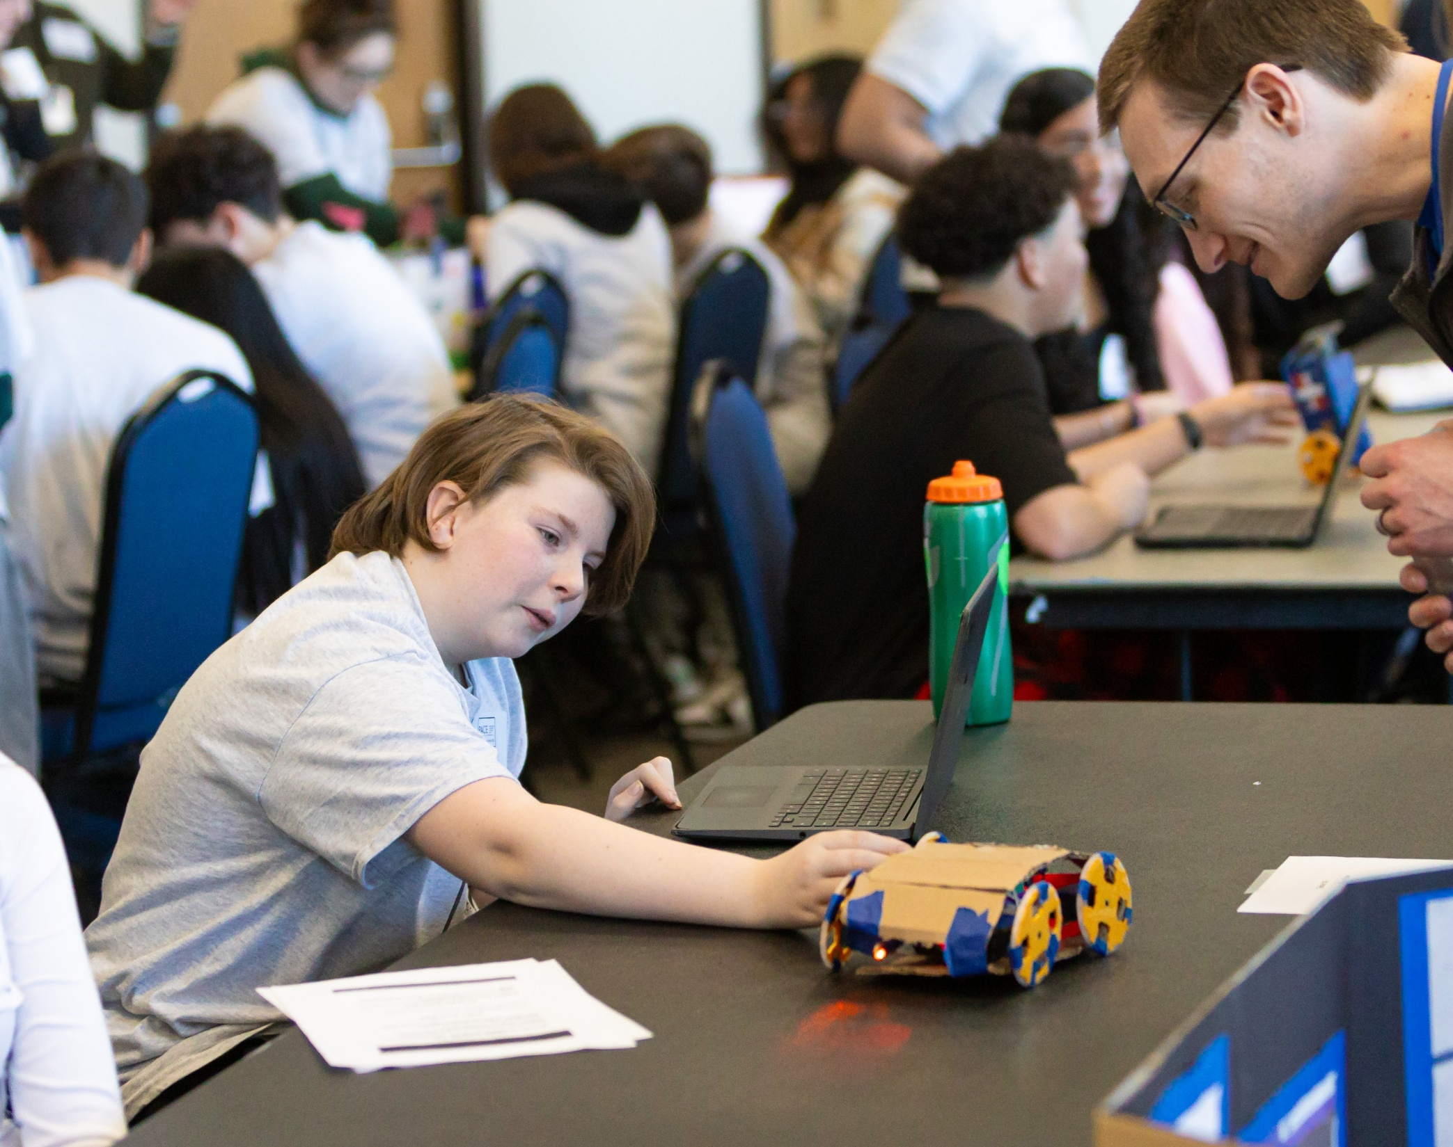
Planning and Implementing Student CS Exhibitions
Anne Wang, EDC
Nadia Foster, EDC
Heidi Larson, EDC

Slide 2
Considerations for Student Exhibitions
Stakeholder engagement
Event logistics
Project selection
Student recognition
Industry involvement
Communications Plan

Slide 3
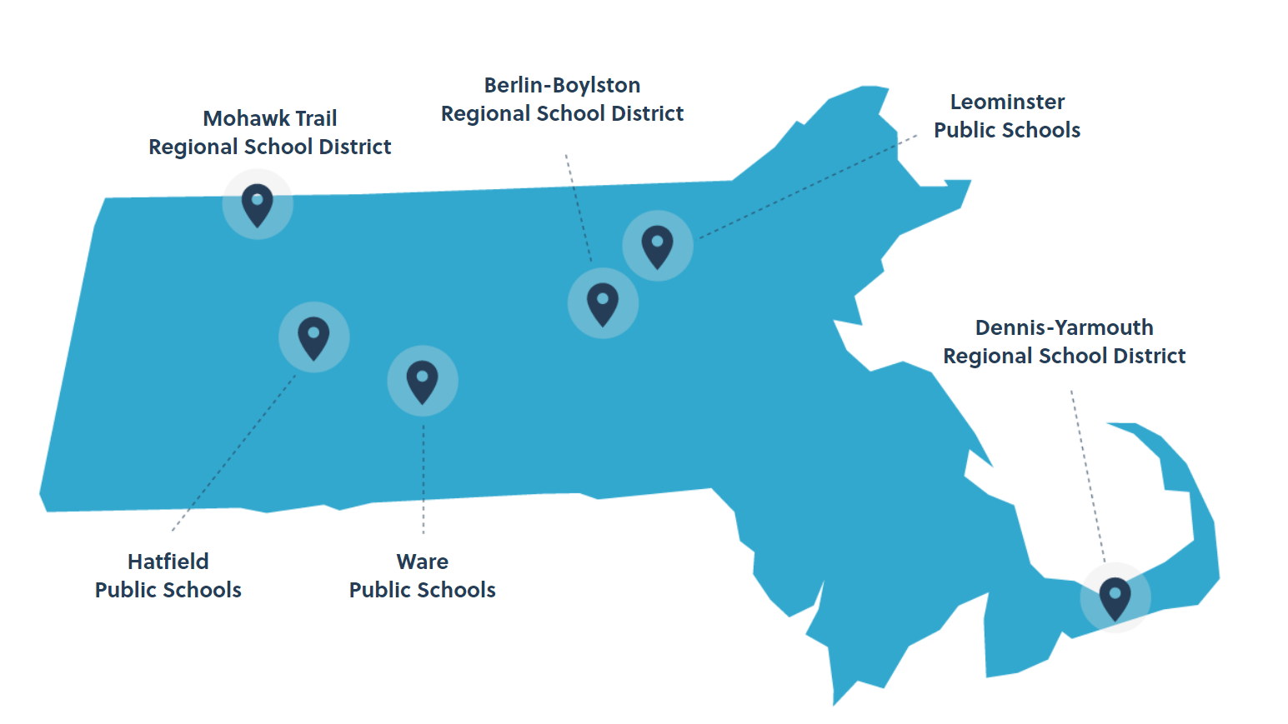
Stakeholder Engagement
PACE:
6 districts teaching similar middle school CS content engaged in whole-district CS systems change
Monthly Community of Practice meetings
Technical Assistance both in CS and in Systems Change

Slide 4
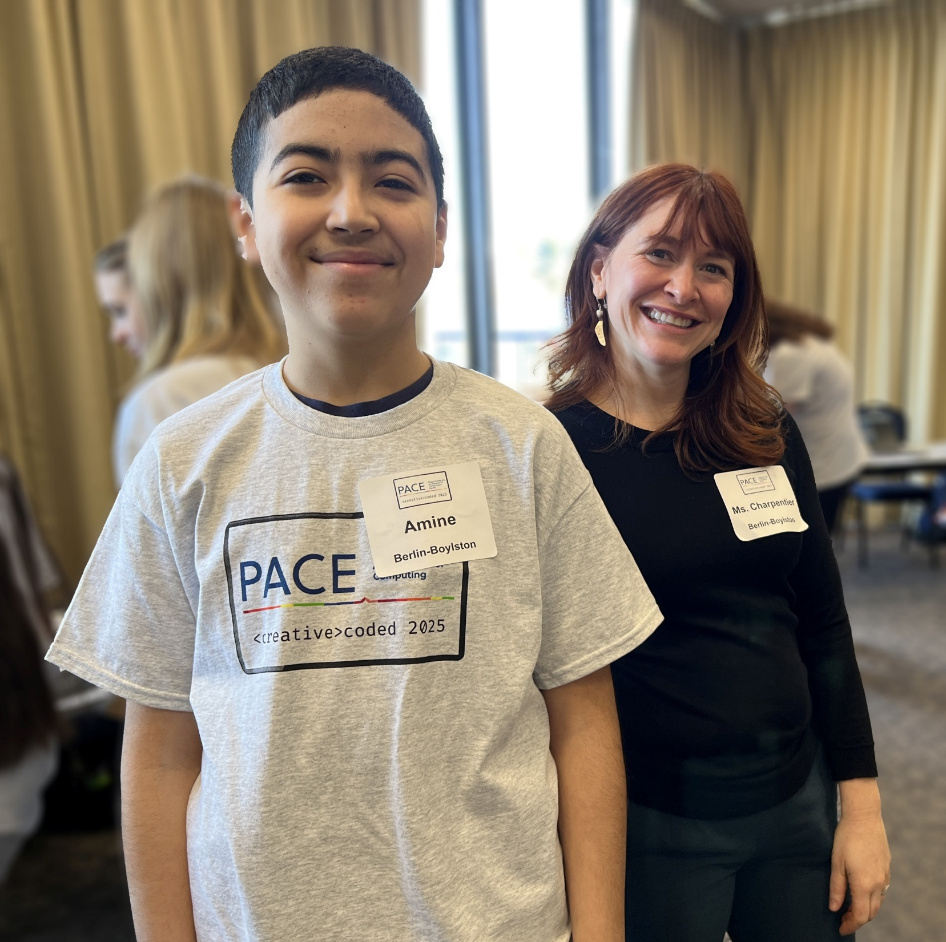
Stakeholder Engagement
Recommendations:
Teacher empowerment
Regular communication

Slide 5
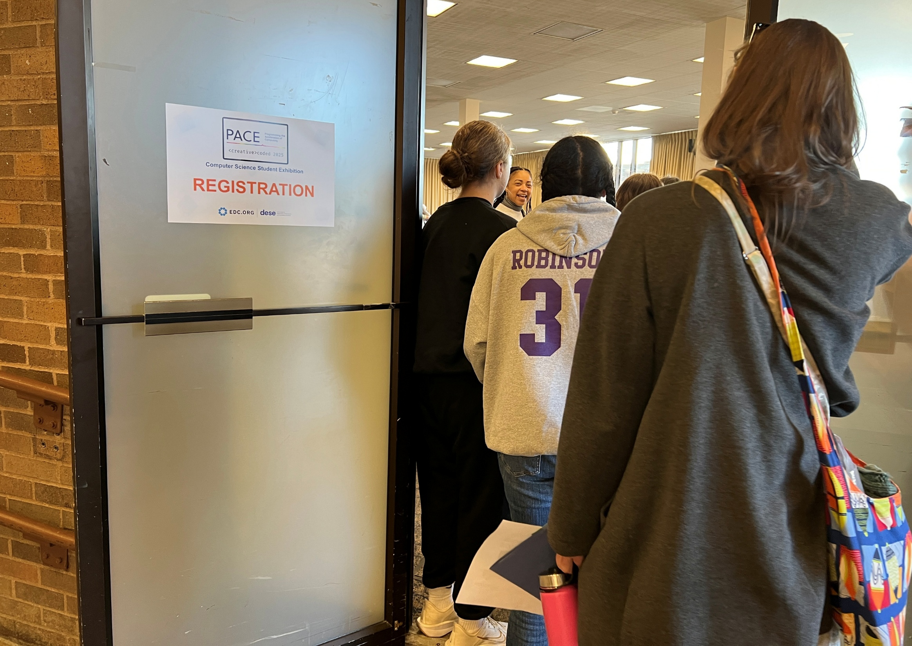
Event logistics
PACE:
Identify a location that will excite students
Solidify a date and time that works for all schools
Create a schedule that is realistic and fun for students
Project planning template
Student registration

Slide 6
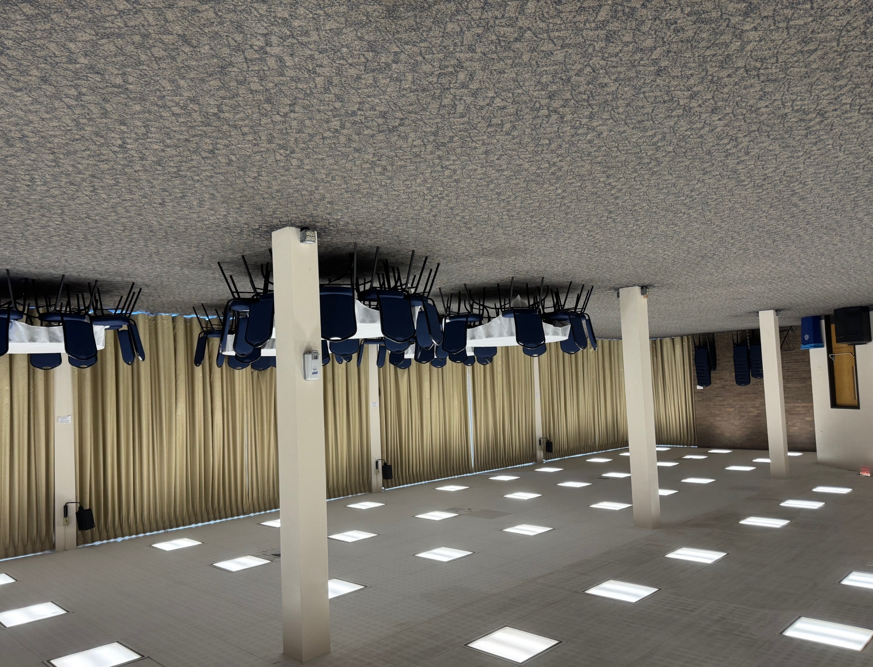
Sample School Communication about the Location
Worcester State University Student Center (Building 12 on Map)
Floor 2 (same floor as Food Court)
We will be using two separate rooms for the event. Both rooms are on the same floor. Both rooms will have WIFI, and we will get the information the day of the event.
BLUE LOUNGE This room will be used for the Student Exhibitions as well as the Opening and Closing sessions. It will be set up with 20 tables in a “fair” style: back-to-back tables with a line down the middle. Each table will have two chairs. We expect most students will want to stand, but the chairs will be available for those who prefer to sit.
This room will also have an AV cart, two microphones, and a registration table. There are outlets around the room. Please bring extension cords for your teams. WSU has a few extra but not enough for the entire event.

Slide 7
Sample Schedule
9:30 AM - 10 AM | Project Setup
10 AM - 10:10 AM | Welcome
10:15 AM - 11 AM | Student Showcase
11 AM - 12 PM | Industry Booth Visits Tour of Worcester State
12 PM - 12:30 PM | Lunch in Dining Hall
12:30 PM - 1 PM | Award Ceremony/Closing Remarks
1:10 PM | Bus Departure

Slide 8
Sample Planning Template
TASK | LEAD | Resource (s) Needed | Deadline | Status | Comments
Secure exhibition location Innovation Center tour |  | Event details
Schedule logistics call w/ site operations: (confirm # of tables & # of staff volunteers) |  |  |  |  | Jane to secure dates and will share with Deb to coordinate; need final capacity.
Student Media/permission form
Catering/ Beverages/Snacks |  | Budget: |  |  | Pizza, sandwich tray, cookie/ brownie & salad trays, paper goods
Exhibition flyer design
Public Relations/ Communications Plan |  |  |  |  | Post-event highlights
AV/Tech
Scavenger Hunt Questions |  |  |  |  | TBD: more details on the student experience stations needed.
Photography/Video
Parent/Community - advertisement
Name Tags
Event signage/ posters/lawn posters & tables
Trophee order & Student certificate design |  | Amazon
Schedule pre-event orientation with industry volunteers
Swag bags (goodie bags, tees, stickers, pens, magnets, H2O bottles, cookies) |  | Amazon
Industry volunteers thank you gifts - # needed |  |  |  |  | District logo branded tees
Post-event surveys for students and industry volunteers

Slide 9
Sample student registration form
School Name | Grade(s) | Teacher Name(s) | Display Needs (electrical outlets) | Adult Media Release
Student Details | First Name | Last Name | Preferred Name (for name tags) | Project name/ group name | Parent/guardian name | Parent/guardian phone number | Parent/guardian email | School permission signed | EDC permission signed | Allergy/medical concerns
no text needed in this column :-)

Slide 10
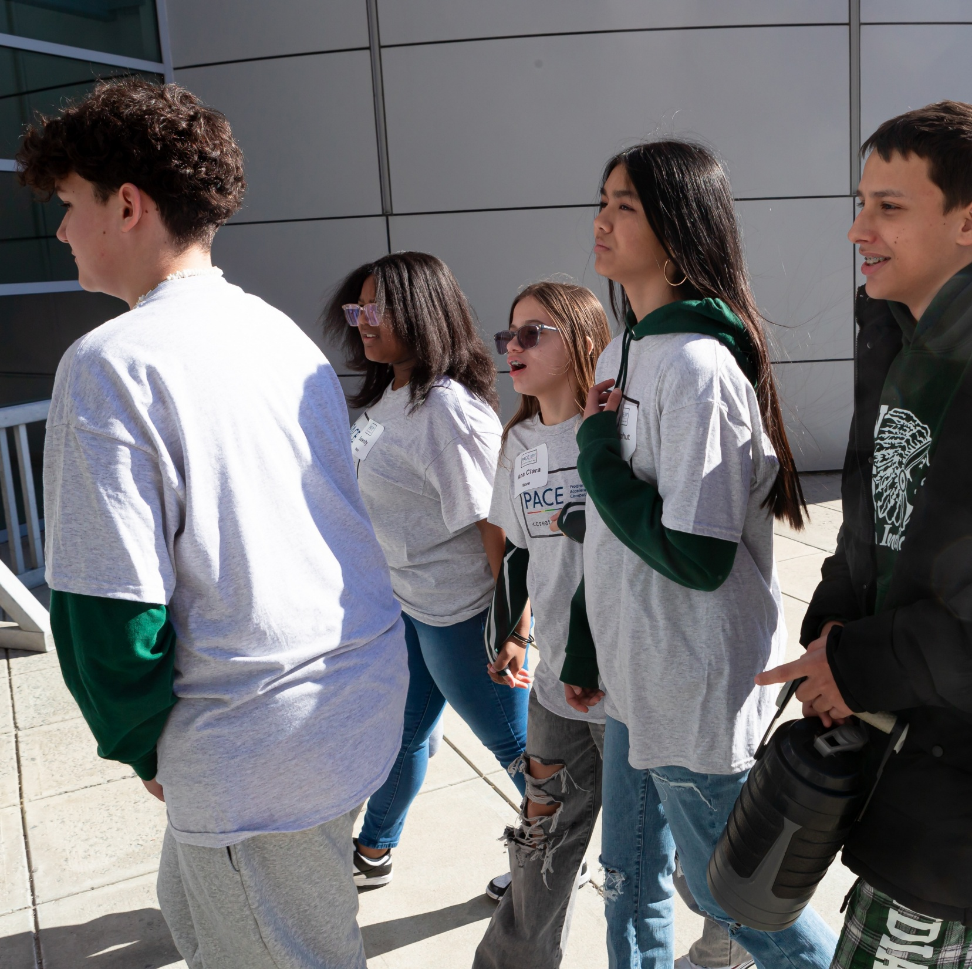
Event logistics
Recommendations:
Identify a date and location early
Have a clear point of contact for the location
Do a walkthrough of the location
Consider student needs (lunch, snacks, recognition, engagement, need for movement)

Slide 11
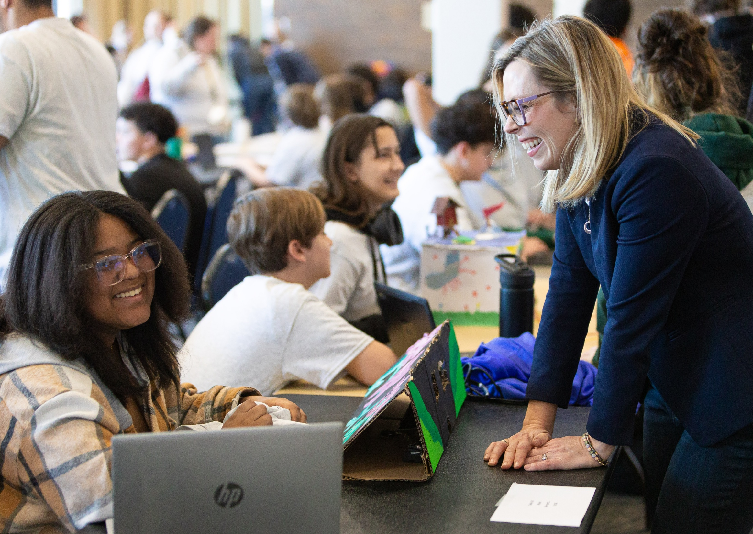
Project Selection
PACE:
Student Exhibition theme with flexibility
Teachers select 3-4 projects per school to present at exhibition
School-level student exhibitions (e.g., shark tank)
Rubrics

Slide 12
Sample judging instructions and project rubric for selecting projects for the exhibition
The Great App Challenge – Judging Instructions
First, thank you so much for helping students out with the projects, they are very excited to let you try their apps!
You will be given a rubric to help you evaluate the projects. You will give each project a grade out of 100. We need to choose the 3 projects that will best represent Ware in the statewide showcase.
Students were directed to create an app that would solve a problem for themselves, their families or their community.
Students should talk about the problem they are solving, the process they took to develop their product and the features of their final product.
Your clipboard contains these instructions and 12 rubrics for teams A – L. Teams M and N are also presenting but not interested/eligible for the showcase.
You should start at the group whose letter is on the blue sticky note on your clipboard and proceed sequentially until you have seen all groups.
PLEASE put the letter for each group that you judge on the rubric for that group.
Curtesy of Kathy Keough Ware CS Teacher
Criteria | Description | Score (0-20) per criteria
Problem Definition | Students describe the problem the app would solve and who would use their app Students explain why the problem was worth solving Students describe the functionality of their app
Documentation | Student present evidence documenting the steps of the design process
App Functionality | The app implements all or most of the functionality stated in the problem definition The app functions correctly without glitches or bugs
Collaboration | Students describe and provide evidence of equitable contribution by all group members.
Presentation | Presentation is clear and easy to understand Presentation describes the problem definition, design process, app functionality and the contributions of all group members. Presenter speaks clearly and at a good pace.
Total

Slide 13
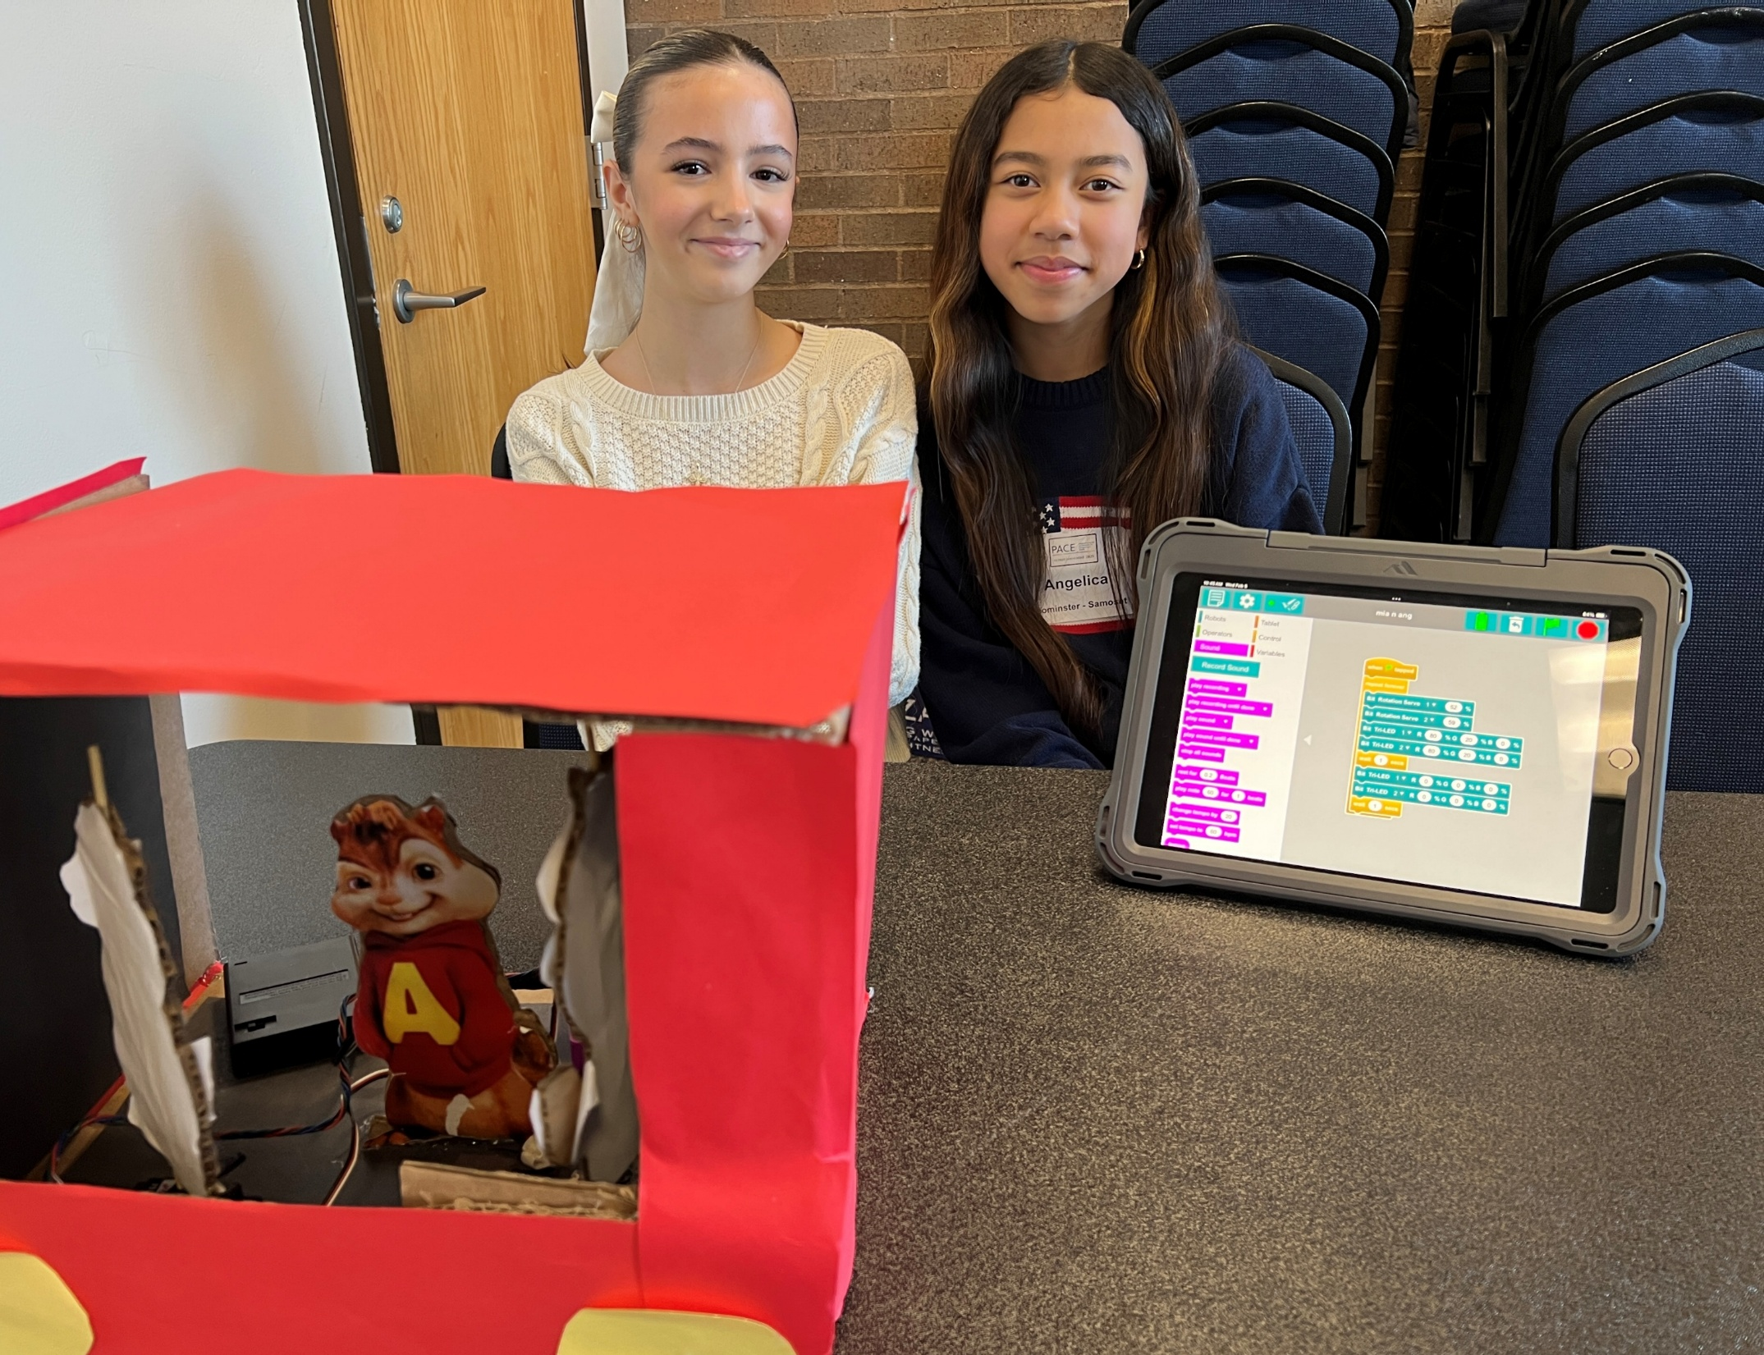
Project Selection
Recommendations:
Fair selection process
Feedback for improvement

Slide 14
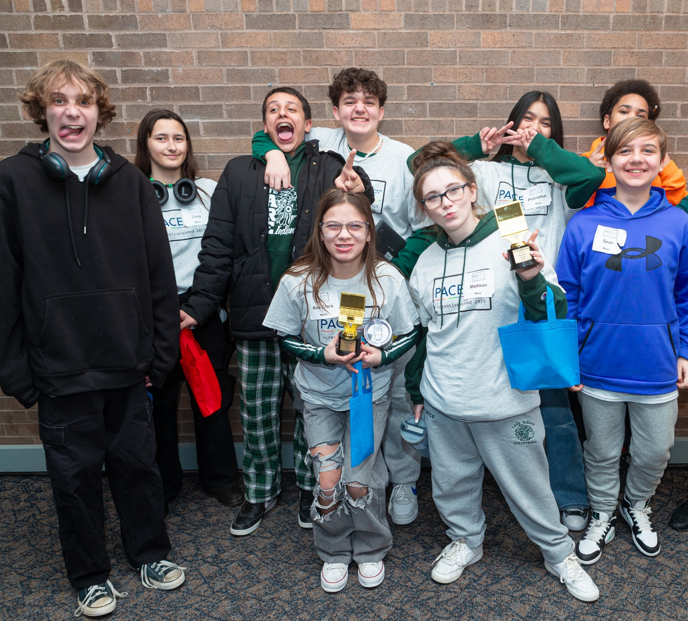
Student Recognition
PACE:
Teams of 2 reviewed all projects using question template
Teams met during lunch to discuss which schools would get which awards
One to two awards per school

Slide 15
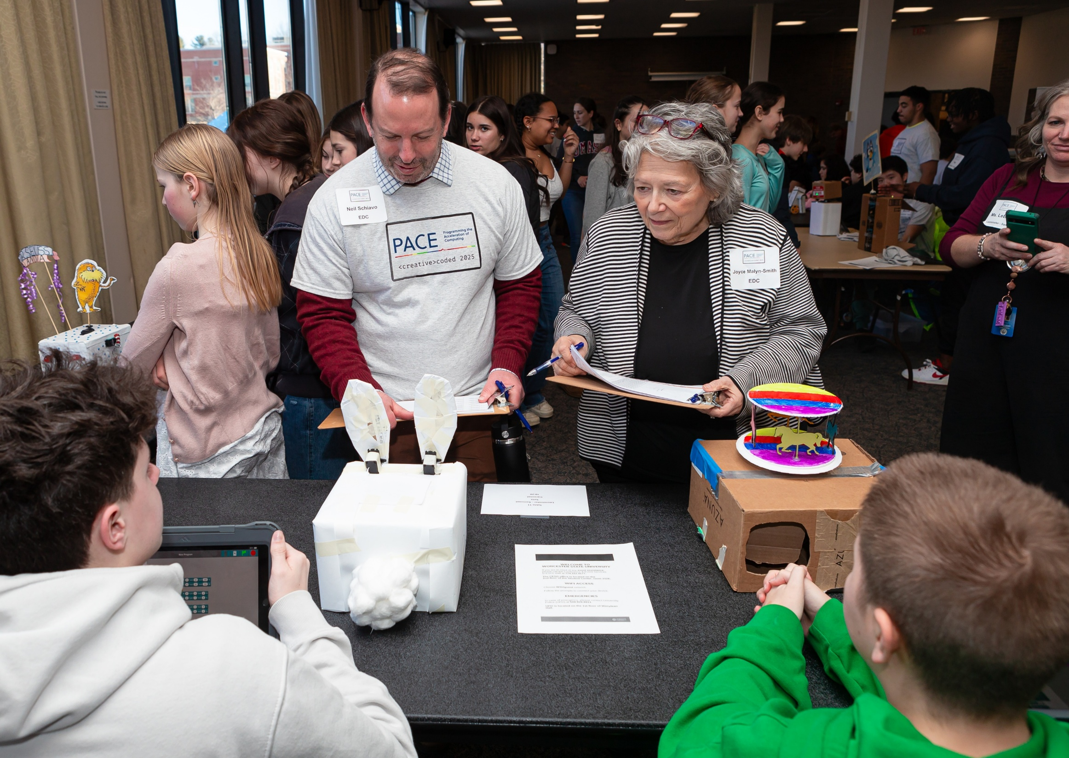
Sample Reviewer Questions
General Questions
What are your names?
What was the most fun part of doing your project?
Project Questions
How did you decide what your project would be?
How does your project reflect what you learned about in your CS class?
Can you demo your project?
Poster Questions (if brought)
Can you please explain your poster to me?
How did you decide what to show on your poster?
Teamwork Questions
What was your job on the team?
Did you like working on a team?
How did your teacher help you?

Slide 16
Sample Awards
Real-World Impact Award
Description: The Real-World Impact Award is presented to the students and teams whose computer science projects have the greatest potential to solve real-world problems and make a meaningful difference in people’s lives. This award recognizes projects that go beyond creativity and technical skill, focusing on practical applications that address challenges in areas such as education, healthcare, environmental sustainability, accessibility, or community improvement.
Criteria for Selection:
Addresses a real-world issue or societal need
Demonstrates thoughtful problem-solving and innovation
Shows potential for real-life application and usability
Effectively communicates the impact of the project
This award celebrates young coders who use technology as a tool for positive change, inspiring them to continue exploring how computer science can improve the world!
Problem Solvers Award
Description: The Problem Solvers Award is given to the students and teams that demonstrate exceptional critical thinking and troubleshooting skills in their computer science projects. This award recognizes those that effectively tackle challenges, overcome obstacles, and find innovative solutions to technical or real-world problems. Whether debugging complex code, optimizing performance, or designing a project that addresses a specific need, they showcase perseverance, creativity, and strong analytical thinking.
Criteria for Selection:
Successfully identifies and solves challenges within their project
Demonstrates resilience and adaptability in troubleshooting issues
Applies logical thinking and creative problem-solving techniques
Clearly explains the problem, the solution, and the process behind it
This award celebrates students who embrace challenges, think outside the box, and use computer science as a tool to solve problems effectively!

Slide 17
Sample Reviewing Template
Time | Table | School/District | Team | Recommended Award | Reason for the Award
10:15 | 21 | Ware | Practice Can | Real World Impact Award Problem Solvers Award Bright Ideas Award Creative Team Award Future Innovators Award
10:20 | 22 | Ware | Cloud Counter | Real World Impact Award Problem Solvers Award Bright Ideas Award Creative Team Award Future Innovators Award
10:25 | 23 | Ware | Math Machine 3000 | Real World Impact Award Problem Solvers Award Bright Ideas Award Creative Team Award Future Innovators Award
10:30 | 24 | Ware | Be quiet… | Real World Impact Award Problem Solvers Award Bright Ideas Award Creative Team Award Future Innovators Award
10:40 | 6 | Hatfield | Propose an App | Real World Impact Award Problem Solvers Award Bright Ideas Award Creative Team Award Future Innovators Award
10:45 | 7 | Hatfield | LED Greeting Cards | Real World Impact Award Problem Solvers Award Bright Ideas Award Creative Team Award Future Innovators Award
10:50 | 8 | Hatfield | LED Greeting Cards | Real World Impact Award Problem Solvers Award Bright Ideas Award Creative Team Award Future Innovators Award
10:55 | 9 | Hatfield | LED Greeting Cards | Real World Impact Award Problem Solvers Award Bright Ideas Award Creative Team Award Future Innovators Award

Slide 18
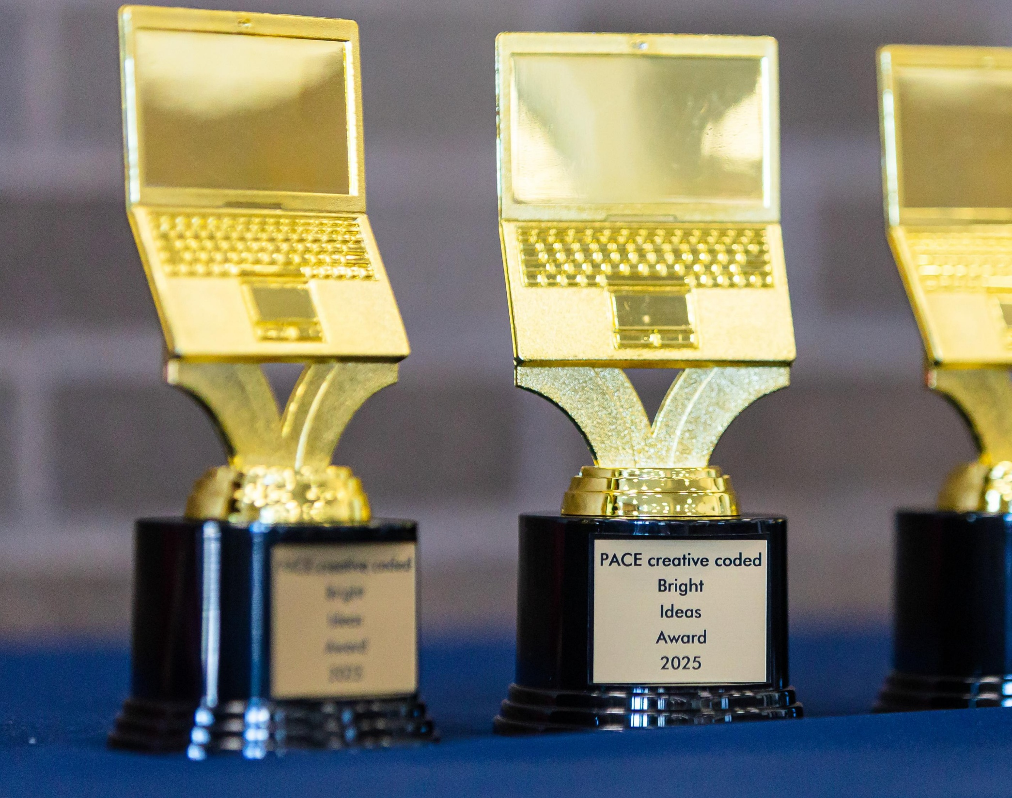
Student Recognition
Recommendations:
Ensure enough time for review of projects and determining awards
Identify awards that celebrate participation and innovation
Certificates for each student

Slide 19
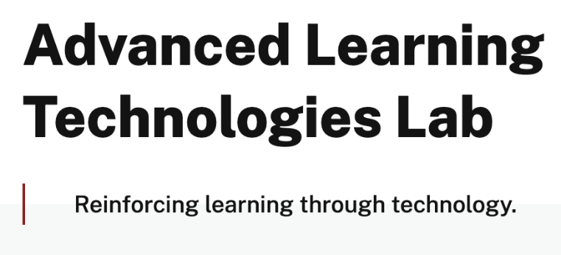
Industry Involvement
PACE:
Solicited 6 industry partners to share about their work and the connection to computer science
Invited them to review student projects and ask questions
Provided tables and space for their exhibits
Developed scavenger hunt with raffle prize to encourage students to visit all industry exhibits

Slide 20
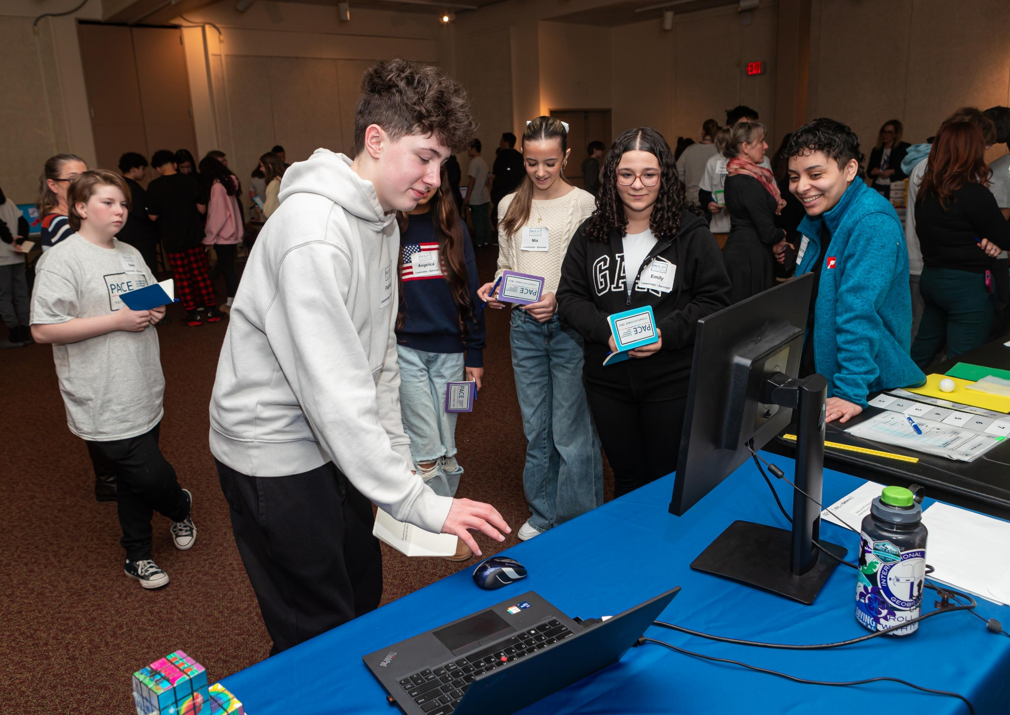
Sample scavenger hunt questions
Name a Lego robotics system that you are interested in.
What types of industries does RLMG create experiences for?
Name one way SpadXTech uses AI or robotics.
What is one way the EcoTarium uses technology to help people learn about the natural world?
Name one YES program STEM project that you found interesting.
What Wearable Devices game would you be interested in coding?

Slide 21
Sample industry spreadsheet
Company Name | Lead | Website | Volunteer (names) | Email/ Phone Number | Notes/ Display description | Status
Google | JS | www.google.com | J. Murphy |  |  | Confirmed

Slide 22
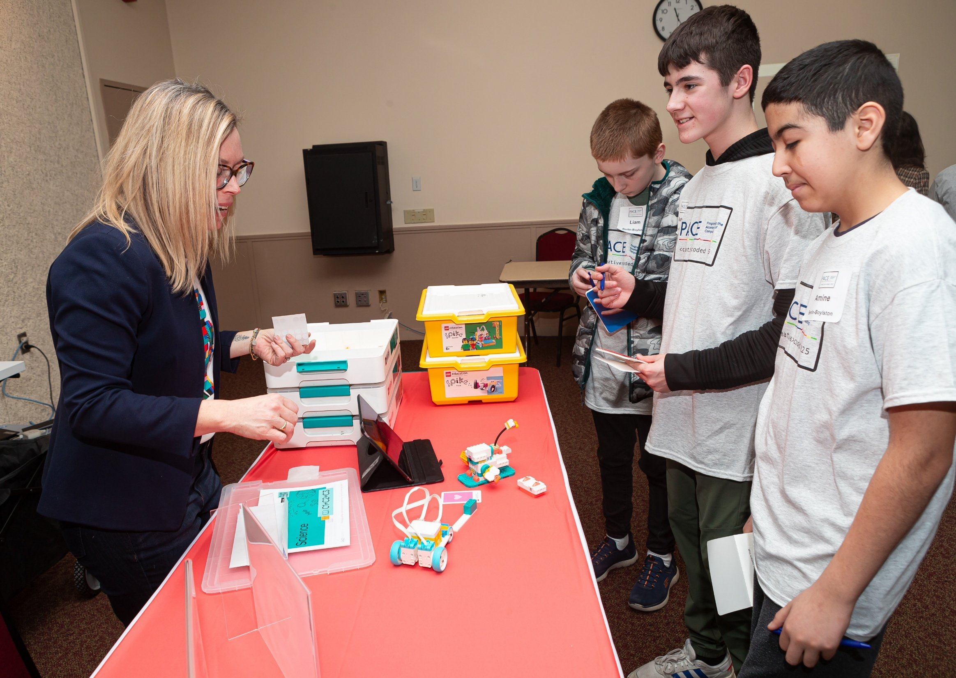
Industry Involvement
Recommendations:
Invite industry partners that are interesting and engaging
Have a team to engage in industry outreach

Slide 23
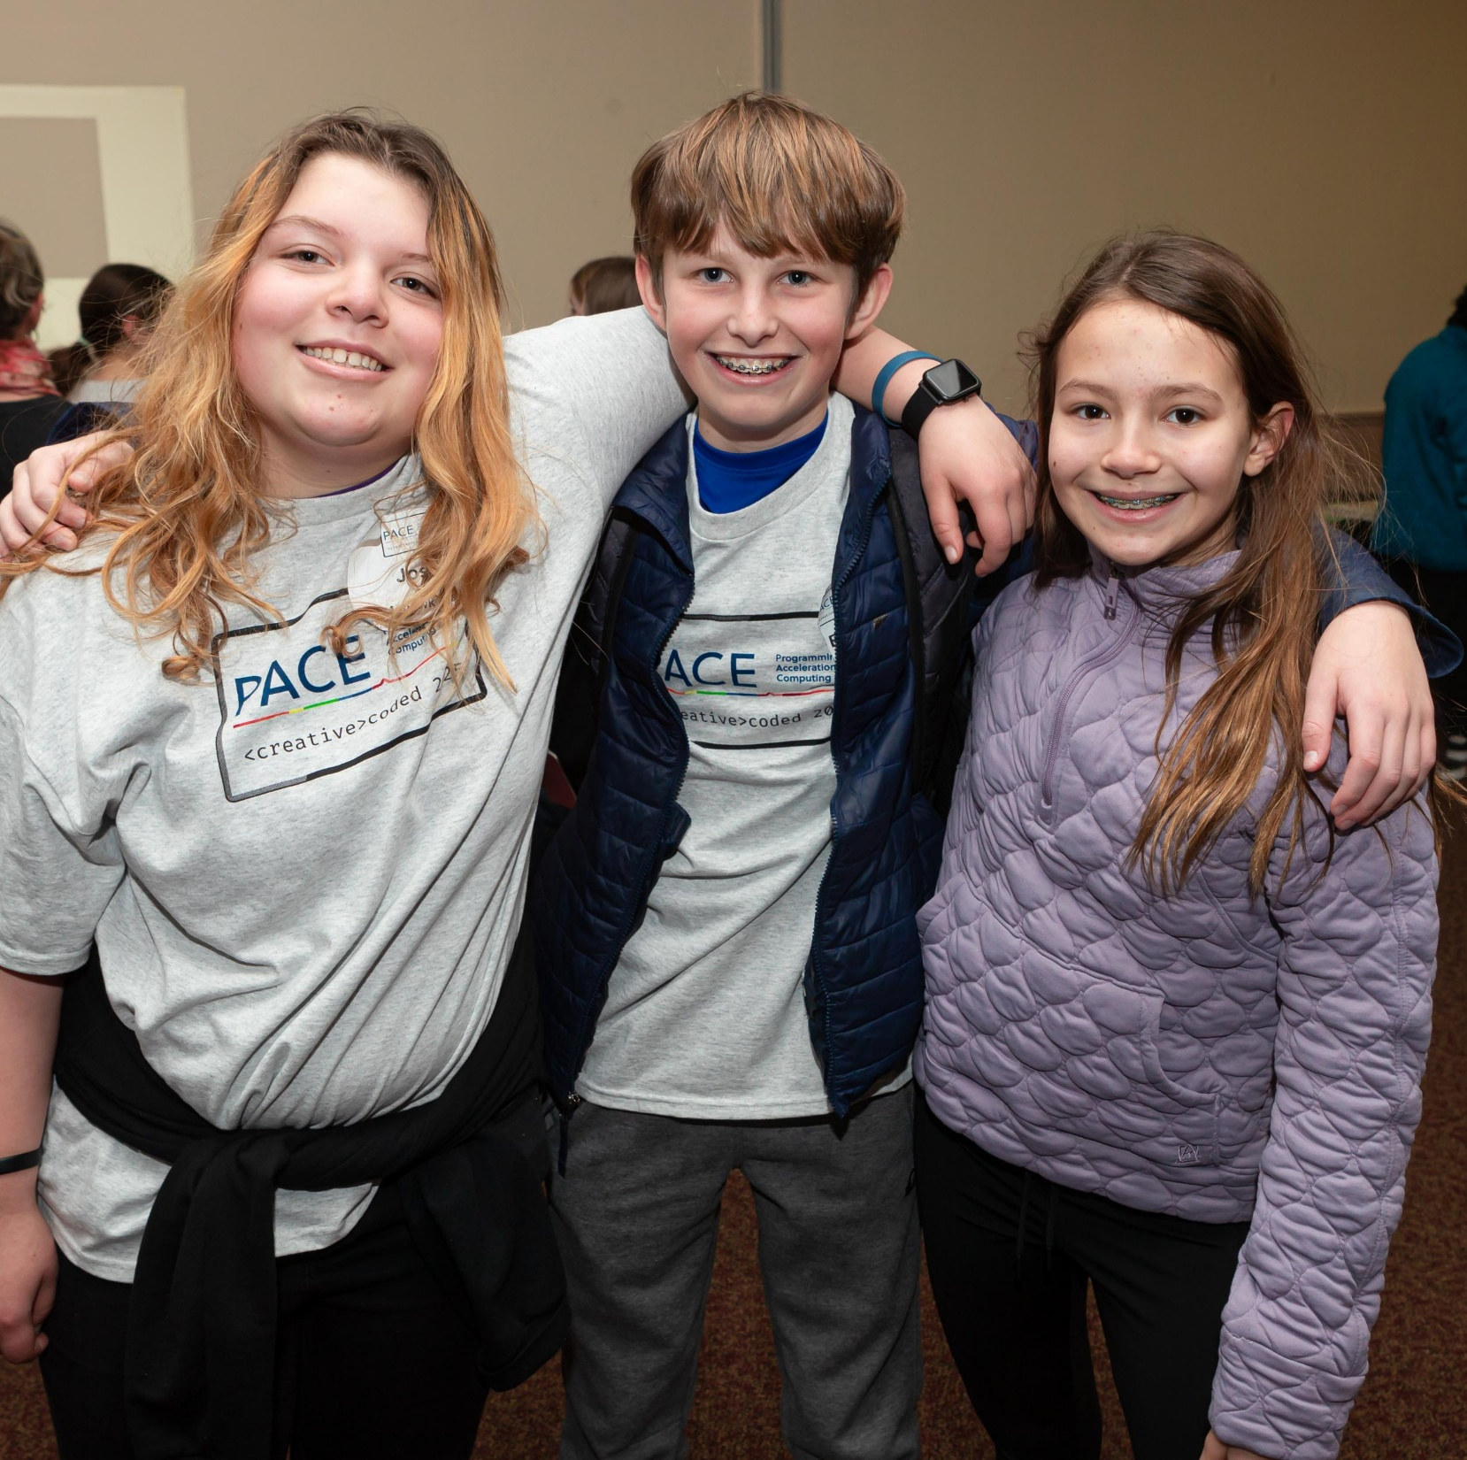
Communications/ Promotion Plan
PACE:
Photo and video releases from students, teachers, and industry representatives
Photographer on site
Outreach to local community media to cover the event
Outreach to the media relations of the event location
Outreach to the host organization to promote the event and celebrate the students

Slide 24
Sample media release form
Your child has been selected to participate with Programming the Acceleration of Computing Education (PACE). PACE is sponsored by Education Development Center (EDC), in partnership with the Massachusetts Department of Elementary and Secondary Education (MA DESE). It is funded under a grant from the U.S. Department of Education, Education Innovation and Research (EIR) Program. EDC is a global nonprofit that advances solutions to improve education, promote health, and expand economic opportunity.
EDC would like to obtain your permission to use photos and videos taken of your child participating in PACE activities, such as PACE Student Exhibitions and workshops. These photos and videos will be used for purposes related to this project and current and future education, research, publication, communication, and promotion purposes, including featuring select photos and videos on our websites and social media.
If you consent to grant EDC rights to the photos, videos, and other related works, please sign the form below and return to your child’s Computer Science teacher.
I confirm that I, _______________________________________, am the parent/legal guardian of ______________________________________.
I voluntarily grant permission to EDC for my child to participate in PACE activities and for use of photographs and audio/video of my child during the event.
By signing this form:
I represent that I am authorized to grant the rights and permissions referred to above, and that this granting of rights will not violate anyone else’s rights.
I understand that EDC may use certain photos, videos, or other related works in whole or in part, and that neither EDC is obligated to use all of the photos, videos, or other related works created during the project.
I waive any right of inspection or approval of the photos, videos, or other related works.
I agree to release EDC and its representatives from liability related to the taking, use, publication, or transfer of such photos, videos, or other related works.
Contact Information
If you have any questions or concerns related to this form, please contact Anne Wang at awang@edc.org.
By signing this release, I represent that I am the custodial parent or legal guardian of the minor named below; I understand the information in this form; and I agree to the terms of this agreement.
(Signature fields below)

Slide 25
Sample pre-event media blurb
MA Students to Exhibit Computer Science Projects at Worcester State University
Middle school students from districts across Massachusetts will be showcasing their computer science talent and projects on Feb. 5 at Worcester State, as part of their participation in Programming the Acceleration of Computing Education initiative (PACE). Each student team will present their projects and take questions. Each district will send between 6-12 students and two teachers. Staff from Education Development Center (EDC), including a media team, will also be in attendance.
Districts sending teams are:
Berlin-Boylston Regional School District
Dennis-Yarmouth Regional School District
Hatfield Public Schools
Leominster Public Schools
Mohawk Trail Regional School District
Ware Public Schools
Timeline for the event:
10-11: student exhibitions and industry booths
11-12: industry booths and students visit campus sites
12-12:30: lunch
12:30-1: closing ceremonies with recognition for each of the teams
About PACE:
The PACE program supports equitable access to high quality, culturally responsive computer science (CS) instruction and CS pathways for middle school students. Since 2019, PACE has partnered with high-needs districts in Massachusetts to help them: 1) expand CS to all middle school students, 2) engage with district and school staff to create an equity vision for CS and strengthen equitable teaching practices in CS, and 3) improve the infrastructure to sustain changes in CS programming. Through representative-based District Stakeholder Councils and other tools and structures, the program focuses on local CS needs, such as engaging more girls and building programs in rural communities.
The PACE initiative is designed to achieve the following outcomes:
Increase student achievement and interest in computer science
Elevate the quality of middle school computer science teaching through training and support
Enable more equitable participation and progression in computer science education by underrepresented, high-need and rural students
Establish strong middle school computer science pathways for high school and Advanced Placement Computer Science
Meet the demand for a workforce with foundational computer science skills and knowledge
PACE is co-led by Education Development Center (EDC) and the Massachusetts Department of Elementary and Secondary Education and is funded by a grant from the U.S. Department of Education, Education Innovation and Research (EIR) Program.
Contact:
For more information about the event, contact Heidi Larson, hlarson@edc.org, 617-618-2886.

Slide 26
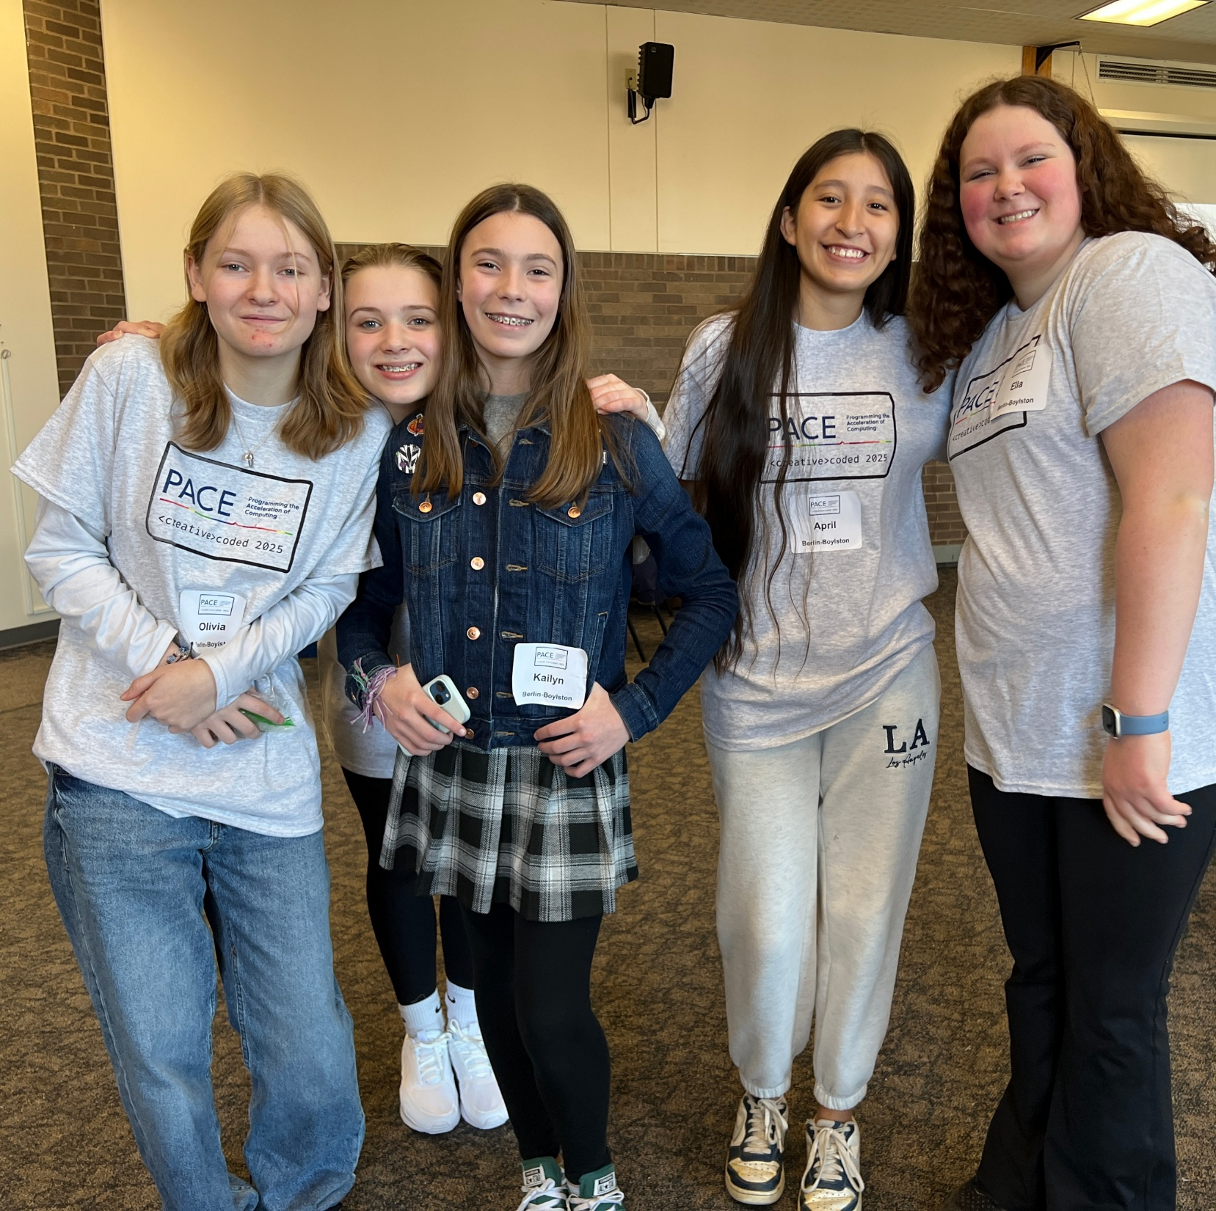
Communications/ Promotion Plan
Recommendations:
Start communications early with identifying potential promotional opportunities
Online media release forms for students and adults
Dedicated photographer/videographer
Capture student voice (e.g., feedback survey)
Follow-up communication to all stakeholders

Slide 27
Questions

Slide 28
Thank you!
To access these slides and for more information about how to implement PACE activities in your district, go to https://pace.edc.org/ or contact:
Anne Wang: awang@edc.org
Nadia Foster: nfoster@edc.org
Heidi Larson: hlarson@edc.org

